Slide 1
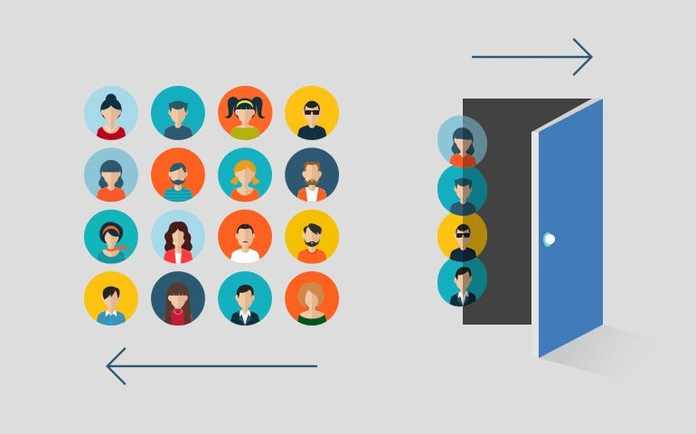
ANALYTICAL CRM DEVELOPMENT FOR - BANK CHURN ANALYSISCRM DEVELOPMENT FOR- BANK CHURN ANALYSIS

Slide 2

Understanding Bank Churn
What Is Bank Churn?
Customer Churn prediction means knowing which customers are likely to leave or unsubscribe from your service. For many companies, this is an important prediction. This is because acquiring new customers often costs more than retaining existing ones. Once you’ve identified customers at risk of churn, you need to know exactly what marketing efforts you should make with each customer to maximize their likelihood of staying.

Slide 4
Factors Contributing to Bank Churn
When analyzing the reasons behind bank churn, several factors comes into play. Understanding these factors can help
Banks Identify areas for improvements and implement strategies to retain customers.
Factors Contributing to Bank Churn
Factor | Description
Customer Satisfaction | Low levels of customer satisfaction can lead to churn. Dissatisfaction with customer Service, long wait times, and Unresolved issues are common reasons why customers churn banks.
Fees and Charges | High fees and charges can be a significant deterrent for customers. If a banks fees are higher compared to or if customers feel they are being charged unfairly, they may choose to switch banks.
Competition | Intense competition in the banking industry can lead to churn, If a competitor offers better rates, incentives, or a more user-friendly experience, customers may be tempted to switch banks.

Slide 5
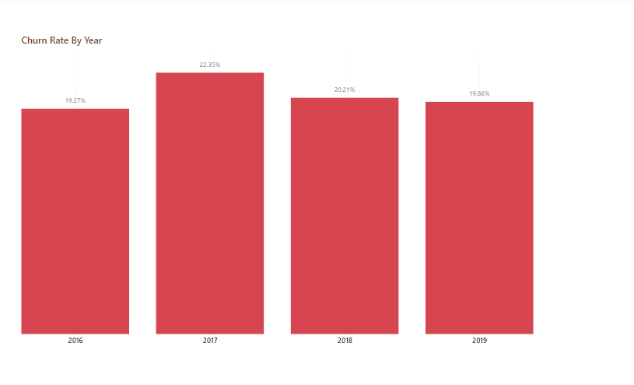

Slide 6
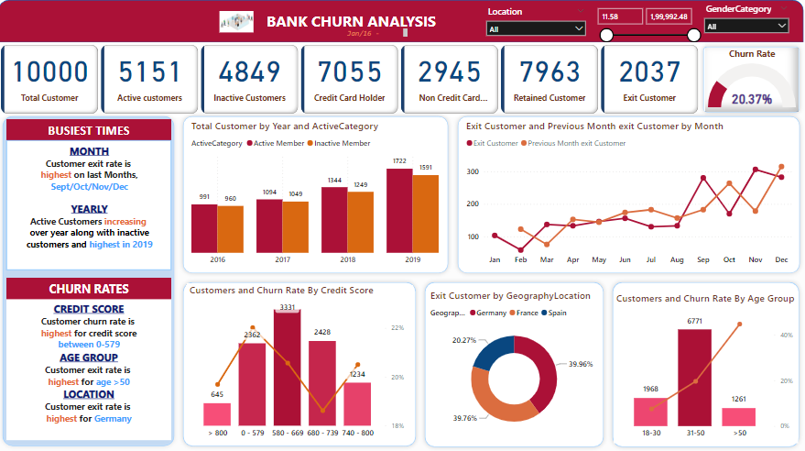

Slide 7
Retention Strategies
Retention Strategies to Reduce Bank Churn
Strategy | Description
Personalized Offers | Provide tailored offers and incentives based on customer preferences and behavior to encourage retention.
Customers Loyalty Programs | Implement loyalty programs that reward customers for their continued business and encourage them to stay with the bank.
Improved Customer Service | Enhance the customer service experience service experiences by providing and personalized assistance, resolving issues efficiently, and addressing customer feedback.

Slide 8
Key Takeaways
Customer Satisfaction
Customer satisfaction is a critical factor in bank churn.
Dissatisfied customers are more likely to switch banks.
Predictive Models
Predictive Models can help identify customers at risk of churn.
By analyzing customers data, predictive models can identify patterns and indicators of churn.
Retention Strategies
Effective retention strategies can help reduce churn.
Providing personalized offers and incentives can incentivize customers to stay with the bank.

Slide 9
THANK YOU!

